Slide 1

CSE 3521: Introduction to Artificial Intelligence
[These slides are partially adapted from the UC Berkeley. CS188 Intro to AI at UC Berkeley]

Slide 2
What makes an AI agent
Agent – an entity that perceives its environment through sensors, and acts on it with effectors (actuators).
Percepts are constrained by Sensors + Environment
Actions are constrained by Actuators + Environment
Sensors
Actuators
Percepts
Actions
Agent
Environment

Slide 3
What makes an AI agent
Agent – an entity that perceives its environment through sensors, and acts on it with effectors (actuators).
Percepts are constrained by Sensors + Environment
Actions are constrained by Actuators + Environment
Sensors
Actuators
Percepts
Actions
Agent
?
Environment
Agent Function (policy) – how does it choose the action?

Slide 4
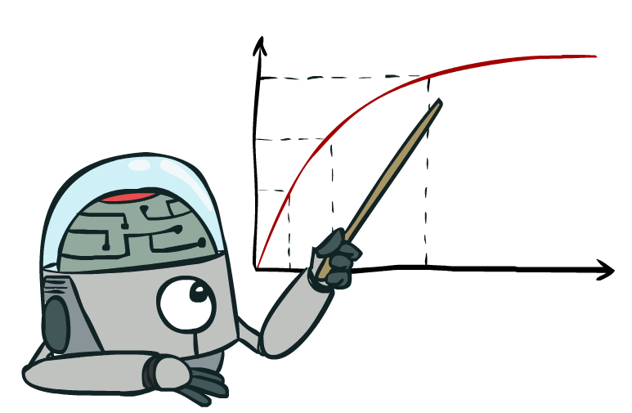
What is a rational AI agent?
A rational agent always acts to maximize its expected performance measure, given current percept/state
Rationality ≠ omniscience
There is “uncertainty” in the environment.
That is why we emphasize “expected”.

Slide 5
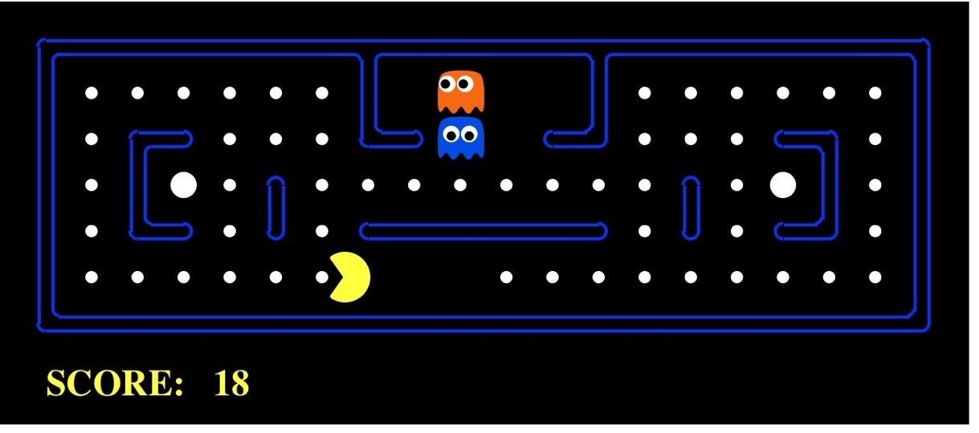

Our Sample Agent
Pacman
Spam Detector
Percepts – squares around Pacman
Actions – move U/D/L/R
Environment – map with walls, dots, and ghosts
Percepts – sender, subject line, body of current email
Actions – mark Spam/Not Spam
Environment – your email inbox

Slide 6
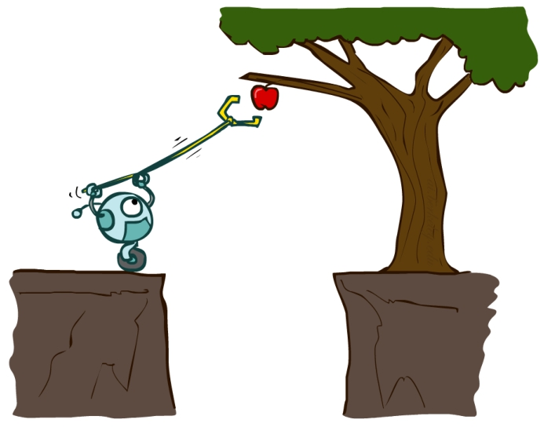
AI – Agents and Environments
Much (though not all!) of AI is concerned with agents operating in environments.
Agent – an entity that perceives its environment through sensors and acts upon that environment through effectors (actuators)
Environment – the problem setting

Slide 7
Kinds of Environments
Six common properties to distinguish environments (not exhaustive)
Fully observable vs Partially observable
Single agent vs Multiagent
Deterministic vs Stochastic
Episodic vs Sequential
Static vs Dynamic
Discrete vs Continuous

Slide 8
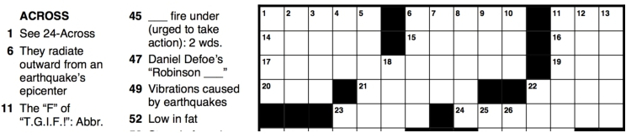

Fully Observable vs Partially Observable
Fully observable
Agent is able to sense everything in the environment
Partially observable
noisy, inaccurate, or incomplete sensors
Notes:
Puzzle vs Poker

Slide 9
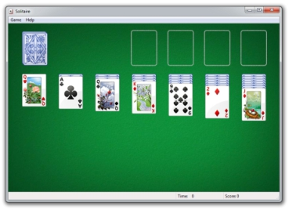

Single Agent vs Multiagent
Single Agent
Self-explanatory
Multiagent
Task involves more than one agent
Each with its own performance measure
May be competitive (measures are opposed) or cooperative (measures are aligned)
Notes:
Solitare vs autonomous driver

Slide 10
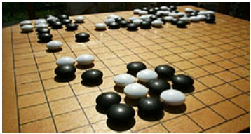
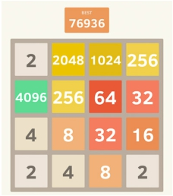
Deterministic vs Stochastic
Deterministic
Next state of the world is fully determined by current state + agent action
Stochastic
it’s not deterministic
https://2048game.com/
Notes:
pinnacle game
2048 is a single-player sliding block puzzle game designed by the Italian web developer Gabriele Cirulli. The game's objective is to slide numbered tiles on a grid to combine them to create a tile with the number 2048.
Stochastic: you don’t’ know where the next “2” will show up

Slide 11


Episodic vs Sequential
Episodic
Each step’s state/decision is independent of the previous ones
Sequential
Each step’s state/decision affects later ones

Slide 12
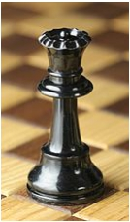
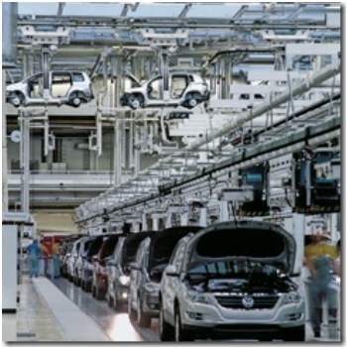
Static vs Dynamic
Static
world doesn’t change while agent is choosing an action
Dynamic
decision time matters!
Notes:
Chase vs production

Slide 13
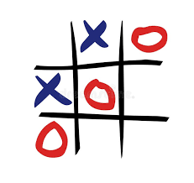

Discreet vs Continuous
Discrete
Possible states/actions are distinct; world changes discretely
Continuous
states/actions take on continuous values
Notes:
Tic-tac-toe vs car driving

Slide 14
These help to find how to approach a problem
Static: focus on getting really high accuracy/utility
Dynamic: trade some utility for higher efficiency (speed!)
Episodic: reflex agent with a great model
Sequential: need a goal oriented agent
Stochastic: need robustness to uncertainty/failure (robots!)
Deterministic: can focus on efficiency and exactness (Internet crawler)

Slide 15
Examples
 | Crossword puzzle | Taxi Driving
Observability
Deterministic vs Stochastic
Episodic vs Sequential
Static vs Dynamic
Discrete vs Continuous
Single vs Multi Agent
Fully
Deterministic
Sequential
Static
Discrete
Single
Partially
Stochastic
Sequential
Dynamic
Continuous
Multi

Slide 16
Examples
 | Crossword puzzle | Taxi Driving
Observability
Deterministic vs Stochastic
Episodic vs Sequential
Static vs Dynamic
Discrete vs Continuous
Single vs Multi Agent
Fully
Deterministic
Sequential
Static
Discrete
Single
Partially
Stochastic
Sequential
Dynamic
Continuous
Multi

Slide 17
Examples
 | Crossword puzzle | Taxi Driving
Observability
Deterministic vs Stochastic
Episodic vs Sequential
Static vs Dynamic
Discrete vs Continuous
Single vs Multi Agent
Fully
Deterministic
Sequential
Static
Discrete
Single
Partially
Stochastic
Sequential
Dynamic
Continuous
Multi

Slide 18
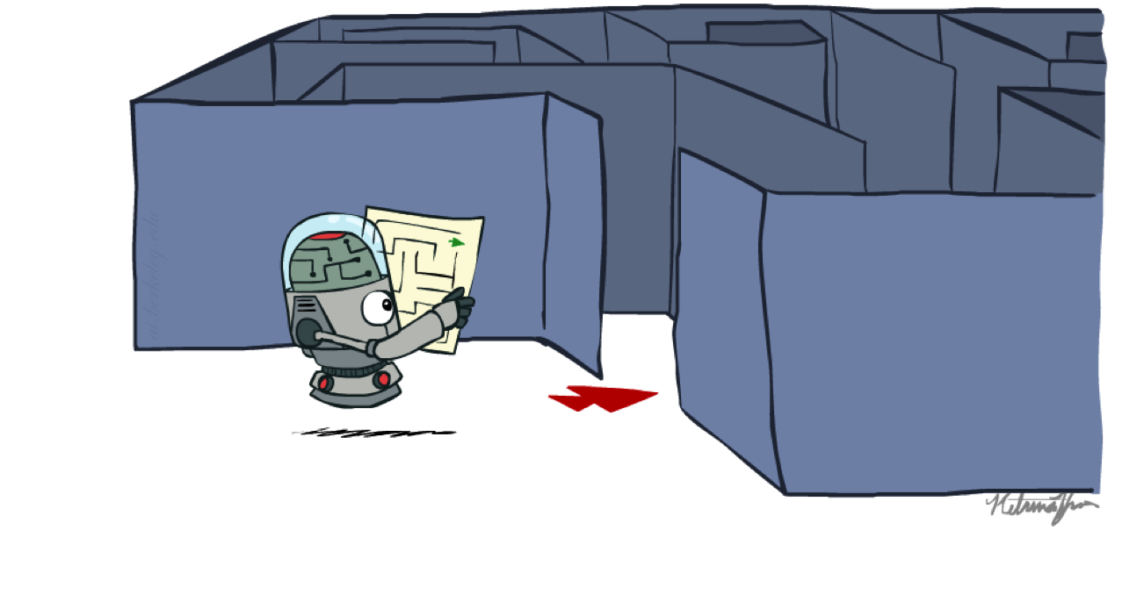
Search

Slide 19
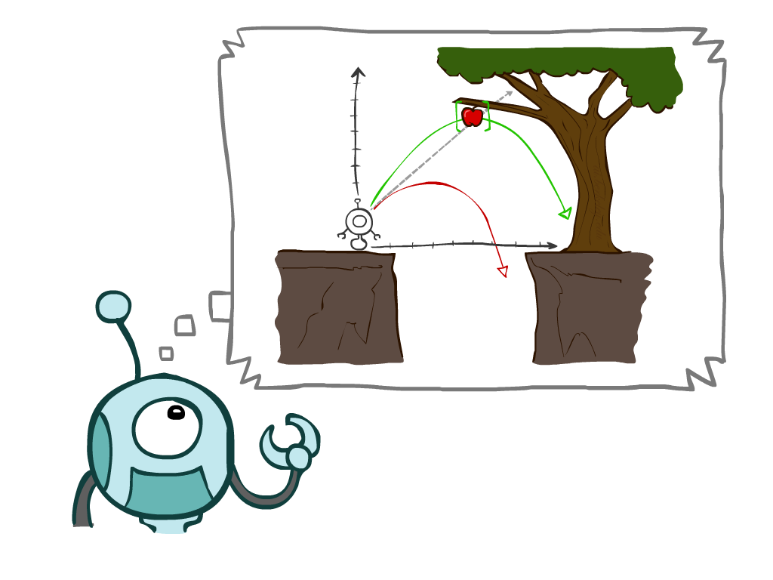
Search Types
Types
Uninformed Search Methods
Depth-First Search
Breadth-First Search
Uniform-Cost Search
Informed Search Methods
Greedy Search
A* Search
Graph searches
Notes:
General theme in the class:
A goal we have in mind.
A mathematical abstraction to formalize this
Algorithms that operate on these abstractions

Slide 20
Agents that Plan Ahead
Planning agents:
Ask “what if”
Decisions based on (hypothesized) consequences of actions
Must have a model of how the world evolves in response to actions
Must formulate a goal (test)
Consider how the world WOULD BE
Optimal vs. complete planning

Slide 21
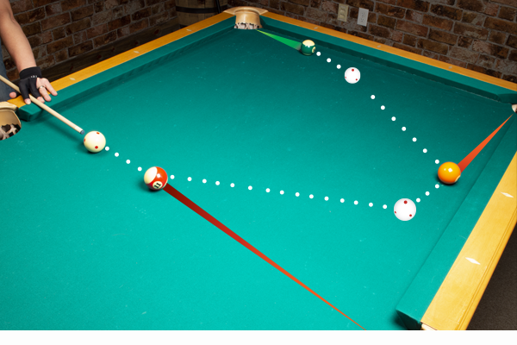
Agents that Plan Ahead
Before taking real actions in the real environment, formulate an off-line problem in a simulated/imaginary environment (model).
The off-line problem:
Has a goal (test)/desired state(s): not necessary the same as the real problem
To find a sequence of actions that can achieve the goal, better with optimal cost/performance measure/utility
Execute the action sequence in the real environment
Execute the first action in the sequence, see how to state changes, and may re-plan!
Notes:
pool

Slide 22

Search Problems
A systematic way to looking for the (optimal) action sequence to reach goal
Not the only way

Slide 23

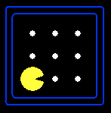





Search Problems
A search problem consists of:
A state space
A successor function
(with actions, costs)
A start state and a goal test
A solution is a sequence of actions (a plan) which transforms the start state to a goal state
“N”, 1.0
“E”, 1.0

Slide 24
Search Problems
A search problem consists of:
A state space
A successor function
(with actions, costs)
A start state and a goal test
A solution is a sequence of actions (a plan) which transforms the start state to a goal state

Slide 25
Example: Traveling in Romania
State space:
Cities
Successor function:
Roads: Go to adjacent city with cost = distance
Start state:
Arad
Goal test:
Is state == Bucharest?
Solution?
If there exists one, it is a sequence of cities from Arad to Bucharest

Slide 26
Example: Traveling in Romania
State space:
Cities
Successor function:
Roads: Go to adjacent city with cost = distance
Start state:
Arad
Goal test:
Is state == Bucharest?
Solution?
If there exists one, it is a sequence of cities from Arad to Bucharest

Slide 27
Example: Traveling in Romania
State space:
Cities
Successor function:
Roads: Go to adjacent city with cost = distance
Start state:
Arad
Goal test:
Is state == Bucharest?
Solution?
If there exists one, it is a sequence of cities from Arad to Bucharest

Slide 28
Example: Traveling in Romania
State space:
Cities
Successor function:
Roads: Go to adjacent city with cost = distance
Start state:
Arad
Goal test:
Is state == Bucharest?
Solution?
If there exists one, it is a sequence of cities from Arad to Bucharest

Slide 29
Example: Traveling in Romania
State space:
Cities
Successor function:
Roads: Go to adjacent city with cost = distance
Start state:
Arad
Goal test:
Is state == Bucharest?
Solution?
If there exists one, it is a sequence of cities from Arad to Bucharest

Slide 30
Example: Traveling in Romania
State space:
Cities
Successor function:
Roads: Go to adjacent city with cost = distance
Start state:
Arad
Goal test:
Is state == Bucharest?
Solution?
If there exists one, it is a sequence of cities from Arad to Bucharest

